Slide 1
Switching

Slide 2
Roles of Switching and Transmission
Transmission
Facilites
Control
Functions
Switching
Facilites
A
Switching center
Transmission Line
B

Slide 3
Fig. 1.1. A two-user network; switching is not required
Roles of Switching and Transmission
Transmission Medium
A
B
When there are only two users, information from A is
by default destined for B, and vice versa
For a two-user network, switching is not required

Slide 4
Fig. 1.2. A three-user network; switching is required
Roles of Switching and Transmission
C
Switching
A
B
Information from A may be destined for B or C
For a three-user network, switching is required

Slide 5
Fig. 1.3. N-user networks with switching performed
(a) at users' location (b) by a central switch
Roles of Switching and Transmission
.
N
.
1
Switching is performed at user’s location by selecting one of the links for reception
.
2
3
# of bi-directional links = N(N-1)/2
.
N
1
.
Switching is performed by a central switch
Central
Switch
.
2
3

Slide 6
An example in which totally centralized switching is not attractive
Roles of Switching and Transmission
user
.
.
.
user
.
Switching
center
.
.
user
Long Transmission Lines
In case the totally centralized switch is not attractive, no communication can be processed between any users

Slide 7
Fig. 1.4. Telephone network hierarchy
Transmission Hierarchy
Higher Level
Hierarchy
i.) Decrease of Traffic volume as going up in hierarchy
Primary Office
.
.
.
ii.) Resources at upper hierarchy shared by larger population
Toll Office
D
.
.
.
.
.
.
LocalOffice(End Office)
.
.
.
A
B
C
Subscribe Loop
iii.) Hierarchical routing

Slide 8


Fig. 1.5. Frequency-division multiplexing
Multiplexing and Concentration
S₁
1
0
1
0
Frequency Modulator
Filter for S₁
Receiver 1
Source 1
.
S₁,S₂,…,S_{N}
.
.
.
.
.
1
0
Frequency Modulator
Filter for S_{N}
1
0
S_{N}
Source N
Transmission Medium
Receiver N

Slide 9
Fig. 1.6. Time-division multiplexing
Multiplexing and Concentration
B bps
Frame
Time Slot
Source 1
Receiver 1
D
E
M
U
X
M
U
X
Source 2
. . .
. . .
Receiver 2
NB bps
Source N
Receiver N

Slide 10
Multiplexing and Concentration
Difference between Multiplexing and concentration :
.
.
I = O in mux. system
I > O in concentrator
.
.
I bits/s
.
.
O bits/s
Difference between Multiplexing and Switching :
Inputs
Outputs
1
1
Connectivity is static in mux, system but dynamic in switching system
2
.
.
2
.
.
.
.
N
N

Slide 11
Fig. 1.7. An N x M concentrator
Multiplexing and Concentration
Input 1
N x M
Concentrator
(N > M)
Output 1
Input 2
Output 2
.
.
.
.
.
.
Input N
Output M
An active input is assigned to one of the outputs. It does not matter which output is assigned.

Slide 12
Fig. 1.8. A Statistical multiplexer
Multiplexing and Concentration
Arriving packets
B bps
Input 1
2
1
Less than NB bps
Input 2
3
.
Statistical
Multiplexer
3
2
1
.
.
Transmission capacity is shared dynamically among the input according to packet arrivals
Input N
Combines multiplexing and concentration
Packet header indicating destination
Switching involved
Connectivity changes with time

Slide 13
Multiplexing and Concentration
Sessions, circuits (concentration) :
Session needs to be set up before communication
Exclusive and non-exclusive dedication of resources during connection
Virtual circuits (not connection oriented)
Messages (Statistical multiplexing) :
variable packets
talk spurts
TASI :
.
.
N x M
.
Satellite Links assigned based on talkspurts
.
.
.
N > M

Slide 14
Timescales of Information Transfer
Packets and Cells :
Transport Entities
Variable versus fixed length
Long versus short packets
Messages are broken into smaller packets in network since:
Network does not support large packet size
Most networks are store-and-forward network, less delay under light load
Prevent a long packet from hogging a communication channel

Slide 15
Concentration used to reduce switching cost
Switch
.
.
.
.
.
.
.
.
Concentrator
.
.
.
.
.
.
.

Slide 16
Circuit Switch Design Principles

Slide 17
Fig. 2.1. An N x N switch used to interconnect N inputs and N outputs
Space-Domain Circuit Switching
Inputs
Outputs
1
.
.
1
2
.
.
2
.
.
N
N

Slide 18
Fig. 2.2. Bar and cross states of 2 x 2 switching elements
Strictly Nonblocking
Bar State
Cross State

Slide 19
Fig. 2.3. (a) Crossbar switch
Strictly Nonblocking
1
Connections:
Input 1 to Output 3
Input 2 to Output 4
2
Inputs
3
4
1
2
3
4
Outputs

Slide 20
Fig. 2.3. (b) banyan switch
Blocking
1
1
2
2
3
3
4
4
Blocking: Input 2 cannot be connected to output 2
if input 1 is already connected to output 1

Slide 21
Nonblocking Properties
RNB
WSNB
SNB
RNB — Rearrangeably Nonblocking
WSNB — Wide-sense Nonblocking
SNB — Strictly Nonblocking

Slide 22
Fig. 2.4. (a) A 4 x 4 rearrangeably nonblocking switch
Rearrangeably Nonblocking
1
1
2
2
3
3
4
4

Slide 23
Rearrangements
1
1
Connection cannot be set up between input 4 and output 1
2
2
3
3
4
4
Fig. 2.4. (b) a connection request from input 4 to output 1 is blocked
1
1
Connection can now be set up between input 4 and output 1
2
2
3
3
4
4
Fig. 2.4. (c) Same connection request can be satisfied by rearranging
the existing connection from input 2 to output 2

Slide 24
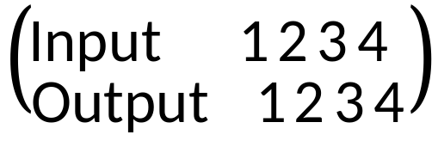
Two states corresponding to the same mapping :
1
1
2
2
3
3
4
4
1
1
2
2
3
3
4
4

Slide 25
Complexity of nonblocking switches :
How to build large switch from smaller switches?
Problems with two-stage networks :
n
1
1
1
1
n
N = mn
# lines = m²n
= mN
Bandwidth expansion factor = m
.
.
.
.
2
2
2
2
.
.
.
.
.
.
.
.
m
m
m
m
(a)
(b)

Slide 26
Fig. 2.5. (a) An example of one-to-one mapping from input to output
1．
2．
3．
4．
．1
．2
．3
．4

Slide 27
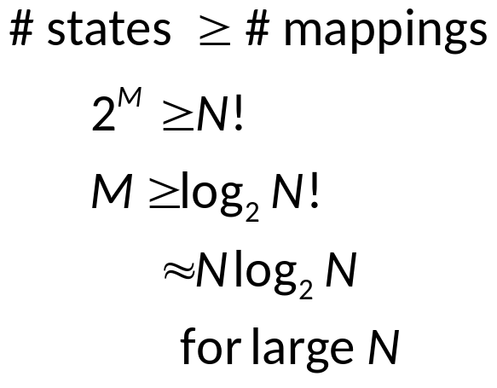
Fig. 2.5. (b) Number of crosspoints needed for nonblocking switch
N! mappings
M crosspoints
1
1
.
.
2
2
.
.
.
.
N
N

Slide 28
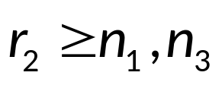
Fig. 2.6. A three-stage clos switch architecture
Clos Switching Network
.
.
.
.
r_{i} — # switch
modules in
column i
n₁ — # inputs in
column 1
module
n₃ — # outputs in
column 3
module
Necessary condition for nonblocking:
.
n₁ × r₂
r₁ × r₃
r₂ × n₃
.
.
(1)
(1)
(1)
.
.
.
.
n₁ × r₂
r₁ × r₃
r₂ × n₃
.
.
.
(2)
(2)
(2)
.
.
.
.
.
.
.
.
.
n₁ × r₂
r₁ × r₃
r₂ × n₃
.
(r₁)
(r₂)
(r₃)
n₁r₁ = n₃r₃ = N for N × N switch

Slide 29
Fig. 2.7. An example of blocking in a three-stage switch
1
1
Key:
Find a commonly accessible middle node from both input and output nodes
2
F
2
3
3
4
4
5
G
B
5
6
6
7
7
8
A
H
8
9
9
A request for connection from input 9 to output 4 is blocked
S_{A} = middle-stage nodes used by A
= { F, G }
S_{B} = middle-stage nodes used by B
= { H }

Slide 30
Fig. 2.8. The connection matrix of the three-stage network
F
G
A
B
H
Stage 3 switch
1
2
B
r₂
1
2
Stage 1 switch
A
F,G,H
r₁

Slide 31
Fig. 2.9. Performing time-slot interchange using space-division switch
Time-Domain Switching
D
E
M
U
X
D
E
M
U
X
Space division switch

Slide 32
Fig. 2.10. Direct time slot interchange using random access memory (switching in the time domain)
Time-Domain Switching
TSI
Write
Read
Write Address Sequence = a, b, c
a
Read Address Sequence = b, a, c
b
c
RAM
Switching in time domain

Slide 33
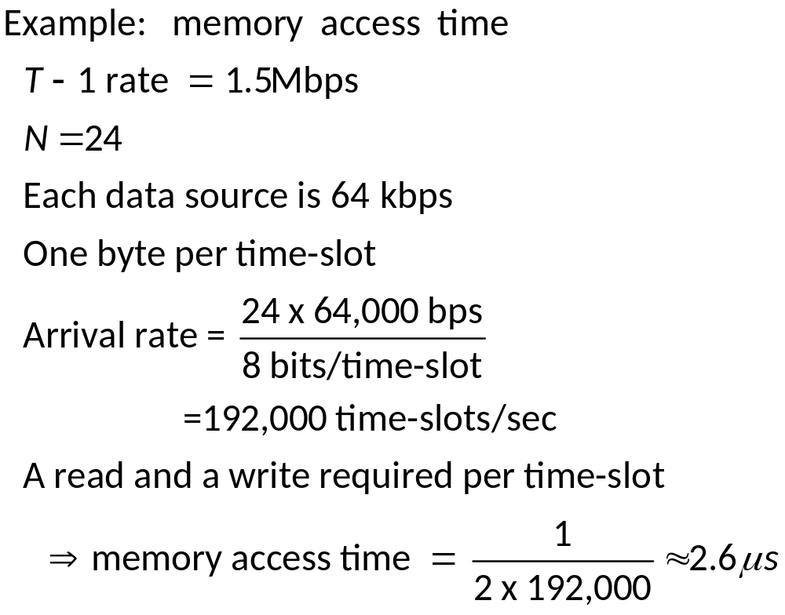
Example for Time-Domain Switching

Slide 34
Fig. 2.11. A time-space-time switch
Time-Space-Time Switching
n
m
m
n
TSI
r x r
TSI
TSI
TSI
.
.
.
.
.
.
TSI
TSI
n, m : number of time slots per frame at various points

Slide 35
Fig. 2.12 A time-space time switch
Time-Space-Time Switching
( i, j ) — data on input i at time-slot j
Frame
TSI
3 x 3
TSI
C(1,3)
B(1,2)
A(1,1)
1
3
2
F(2,3)
E(2,2)
D(2,1)
TSI
TSI
3
1
1
L(3,3)
H(3,2)
G(3,1)
TSI
TSI
2
2
3
Targeted Outputs

Slide 36
Fig. 2.13. Equivalent of time-space-time switching and three-stage space switching
Time-Space-Time Switching
A(1,1)
M
U
X
M
U
X
D(2,1)
CBA
BAC
EDC
CED
B(1,2)
TSI
TSI
E(2,2)
(1)
(1)
C(1,3)
C(1,3)
D(2,1)
M
U
X
M
U
X
A(1,1)
E(2,2)
FED
TSI
EDF
HAL
TSI
LHA
H(3,2)
(2)
(2)
F(2,3)
L(3,3)
G(3,1)
M
U
X
M
U
X
G(3,1)
H(3,2)
LHG
TSI
HGL
BGF
TSI
GBF
B(1,2)
(3)
(3)
L(3,3)
F(2,3)

Slide 37
Fig. 2.14. Input-output mapping changes from slot to slot in space-division switch in time-space-time switching
3 x 3
B(1,2)
A(1,1)
C(1,3)
E(2,2)
D(2,1)
C(1,3)
E(2,2)
D(2,1)
F(2,3)
H(3,2)
A(1,1)
L(3,3)
H(3,2)
G(3,1)
L(3,3)
B(1,2)
G(3,1)
F(2,3)
( i, j ) — data on input i at time slot j
Time Slot 1
Time Slot 2
Time Slot 3

Slide 38
Fig. 2.25. Equivalent of time-space-time switching and three-stage space switching
These lines correspond to time slot 1
A(1,1)
D(2,1)
B(1,2)
E(2,2)
C(1,3)
C(1,3)
(1)
(1)
(1)
D(2,1)
A(1,1)
E(2,2)
H(3,2)
F(2,3)
L(3,3)
(2)
(2)
(2)
G(3,1)
G(3,1)
H(3,2)
B(1,2)
L(3,3)
F(2,3)
(3)
(3)
(3)
Module (i) corresponds
to input TSI (i) in
time-space-time switch
Module (i) corresponds
to time slot i of
space-division switch in
time-space-time switch
Module (i) corresponds
to output TSI (i) in
time-space-time switch

Slide 39
Thank You.

